Slide 1
South Korea Covid-19 Cases Prediction
MATH 535: Statistical Learning and Data Mining. Spring 2021
Researches: Yeheng Liang,Thi Van Nguyen,
Matthew Heym, Hanzhu Yan
Instructor : Xingye Qiao
Binghamton University

Slide 2

1. Introduction
Coronavirus diseases 2019(COVID-19)
An infectious disease caused by severe acute respiratory syndrome coronavirus 2 (SARS-CoV-2)
First reported in December 2019 in Wuhan, China, and has resulted in an ongoing pandemic
Total number of confirmed cases passed over 150 millions in over 185 countries
Resulting in more than 3.1 millions deaths
South Korea has been one of the most successful countries at rapidly controlling transmission rates.
Coronavirus (STAT News)

Slide 3
Our Goal:
Using LDA, QDA,PCA, K-means for classification and clustering by provinces
Find significant association between weather data, time age data, policy data and search trend data with new COVID cases.
Predict new COVID cases using weather data, policy data and search trend data.

Slide 4
2. Data Exploration & Visualization
Data set
From kaggle:url{https://www.kaggle.com/kimjihoo/coronavirusdataset}
Shows the detailed Covid-19 confirmed cases from 1/1/2020 to 6/30/2020
Includes sub data set with different aspect (weather, age, province,time, policy, etc.…) about COVID-19
Later, we use the weather data, search trend data, and policy data for prediction

Slide 5
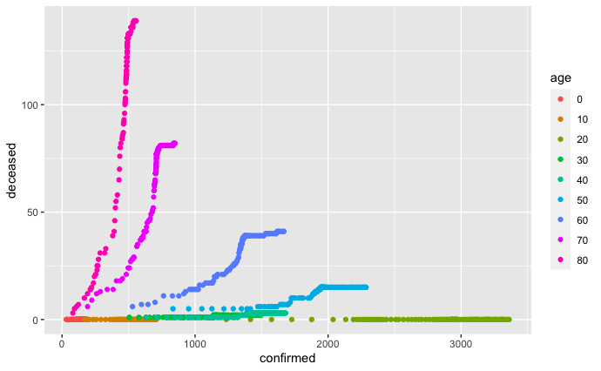
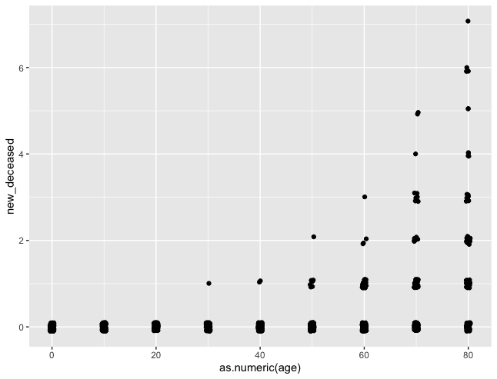
2.1 Significance of Age

Slide 6
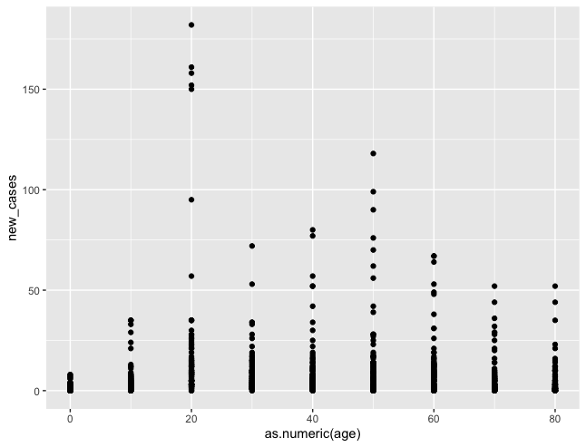
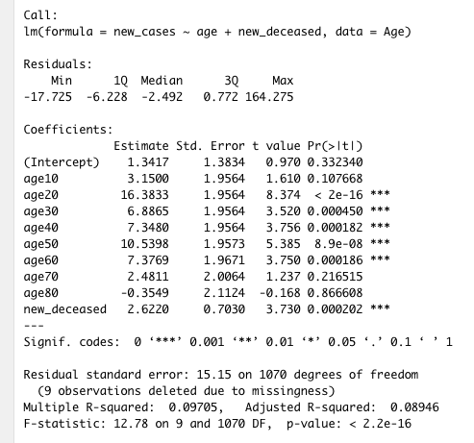
2.1

Slide 7
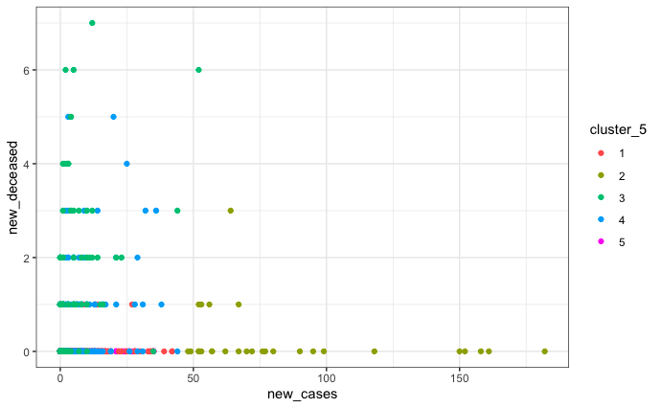
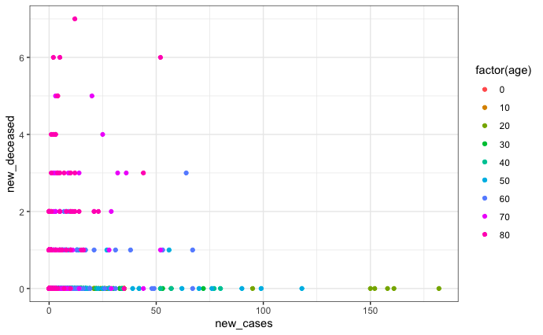
2.1 K means and Age (Unscaled)

Slide 8
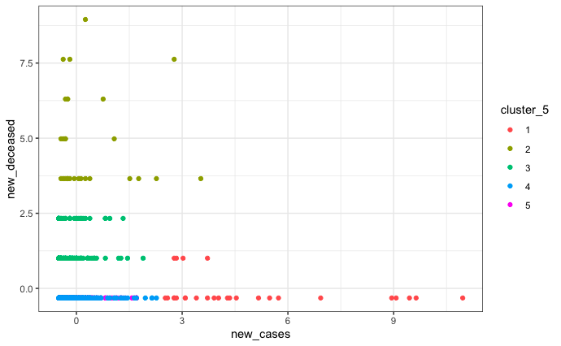
2.1 K means and Age (Scaled)

Slide 9
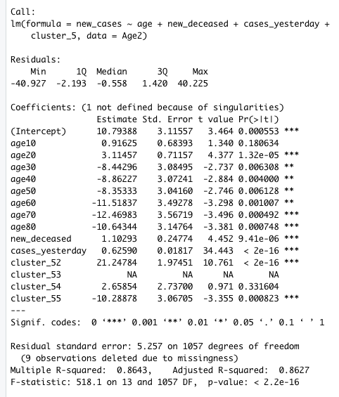
2.1
Data Visualization - K means Clustering with age
Age is very significant when formulating the clusters
Multiple regression with clustering depicts cluster 2 having 21 more new cases than baseline cluster 1
Clustering with age regression has good R^2 = .86,

Slide 10
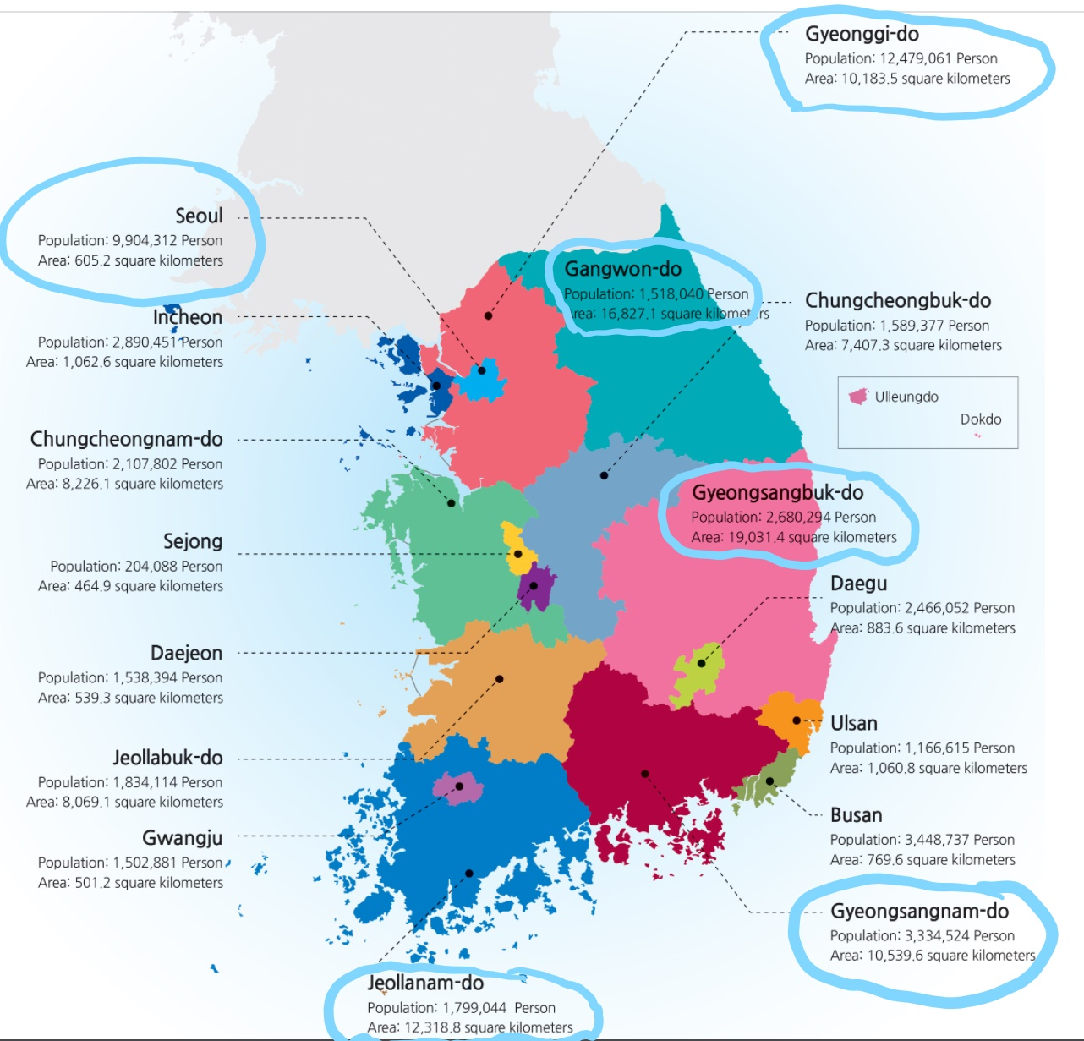
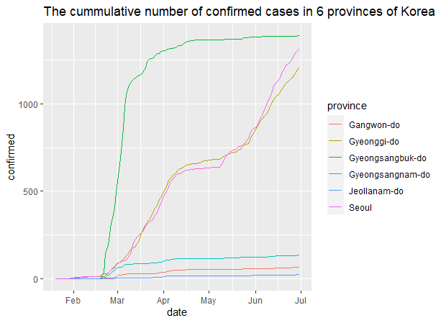
2.2 Classification and clustering by provinces

Slide 11
2.2 Classification and clustering by provinces
Method
LDA
QDA
PCA
K-means
Data Splitting: randomly split ⅔ for training dataset and ⅓ for test dataset.
Predictors
7 Climate features
avg_temp: the average temperature
min_temp: the lowest temperature
max_temp: the highest temperature
precipitation: the daily precipitation
max_wind_speed: the maximum wind speed
most_wind_direction: the most frequent wind direction
avg_relative_humidity: the average relative humidity
7 geographical attributes
elementary_school_count: the number of elementary schools
kindergarten_count: the number of kindergartens
university_count: the number of universities
academy_ratio: the ratio of academies
elderly_population_ratio: the ratio of the elderly population
elderly_alone_ratio: the ratio of elderly households living alone
nursing_home_count: the number of nursing homes

Slide 12
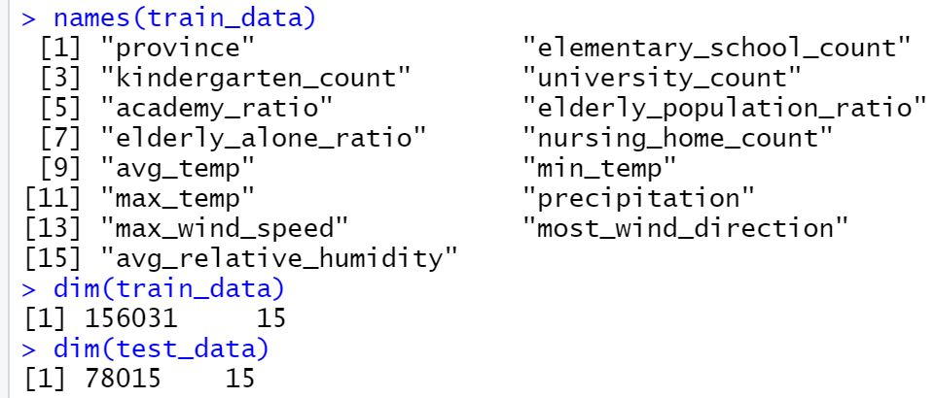
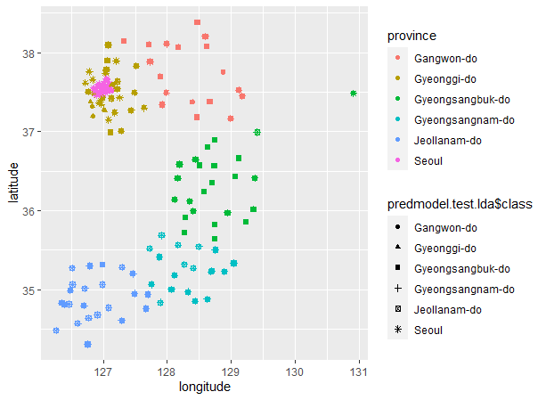
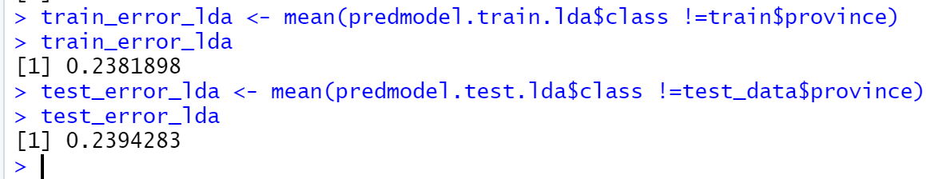
2.2 LDA

Slide 13
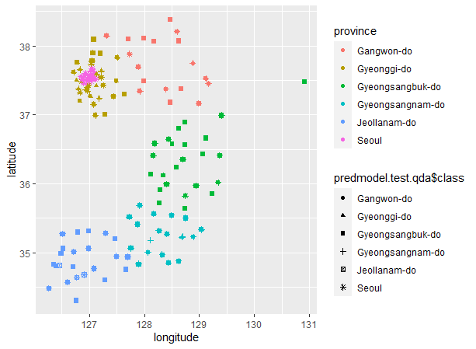
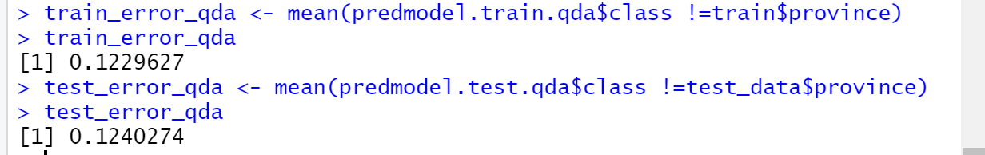
2.2 QDA
QDA better than LDA for test_error

Slide 14
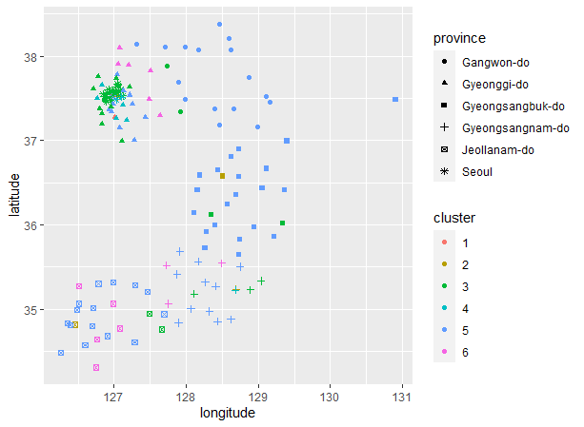
2.2 K-means
Using the same data of LDA and QDA without the province labels.
The clusters don’t match with provinces

Slide 15
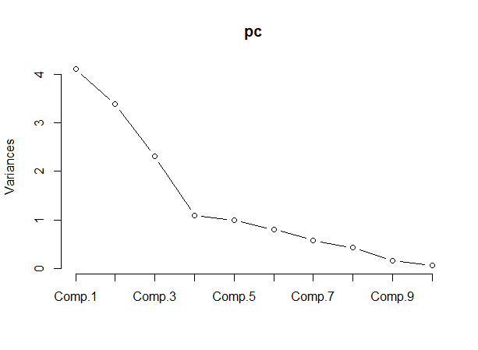
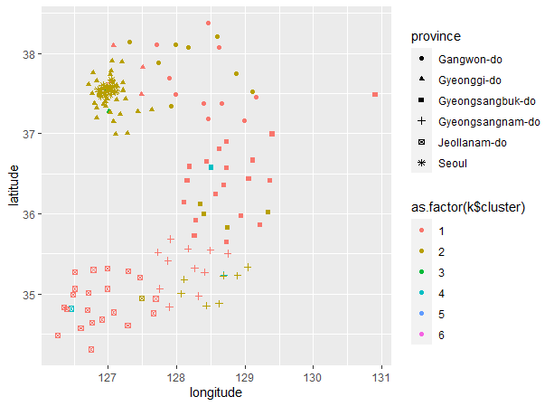
2.2 PCA and K-means
Using the same data of LDA and QDA without the province labels.
apply principal components to the scaled data then use k-means with 4 principal components
The clusters don’t match with provinces.

Slide 16
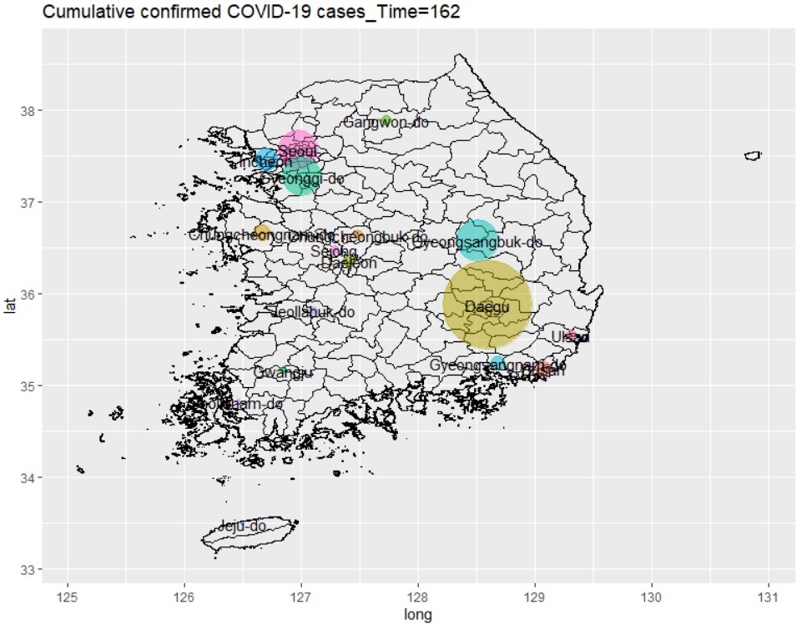
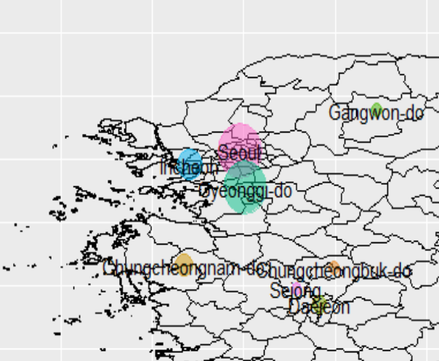
3.1 Data Cleaning
Group the raw data(Region,Search Trend, Time Province,Weather) by province and focus on Seoul, Incheon, and Gyeonggi Do.

Slide 17
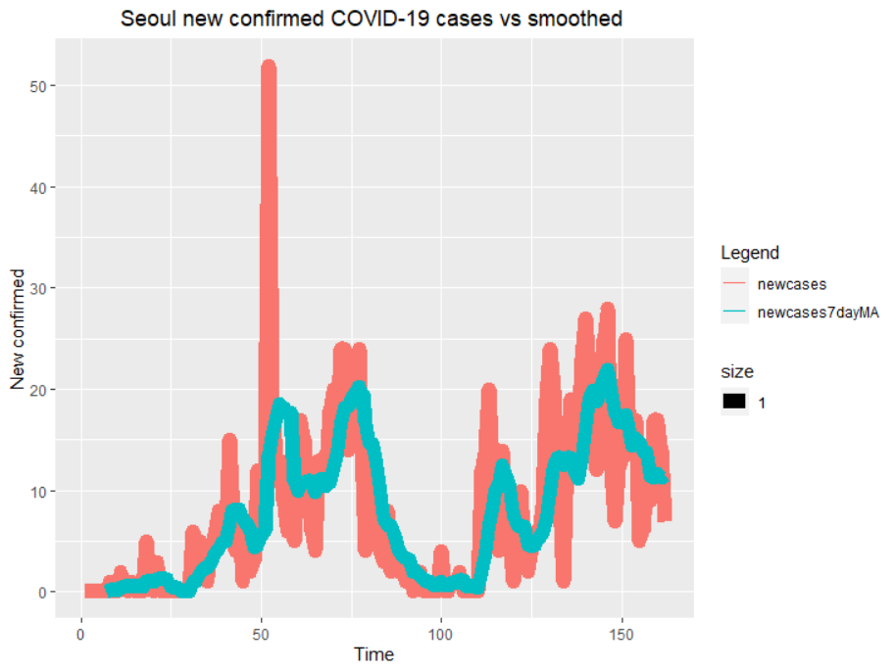
3.2 Data Cleaning
Handle autoregressive errors by taking first differences procedure of cumulative confirmed.
Take 7 day moving average of new confirmed to smooth the curve and remove noise.
Response: 7 Day Moving Average of New Confirmed case

Slide 18
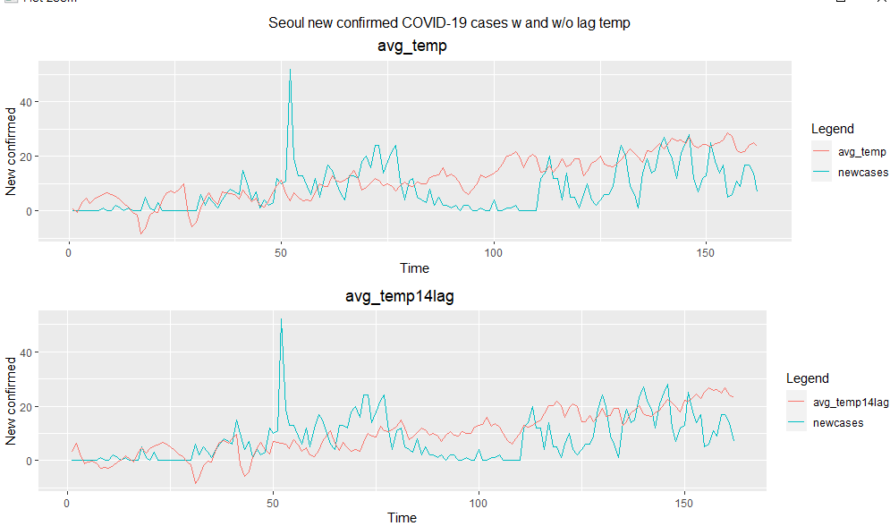
3.3 Data Cleaning
Four main predictor components:
Y_{t-7}: 7 Day Moving Average of New Confirmed case 7 day ago
Weather
Policy
Search Trend
Take 14 days lag of Weather and Policy
Why?
Accommodate for Incubation period of Covid-19 (as long as 21 days).

Slide 19
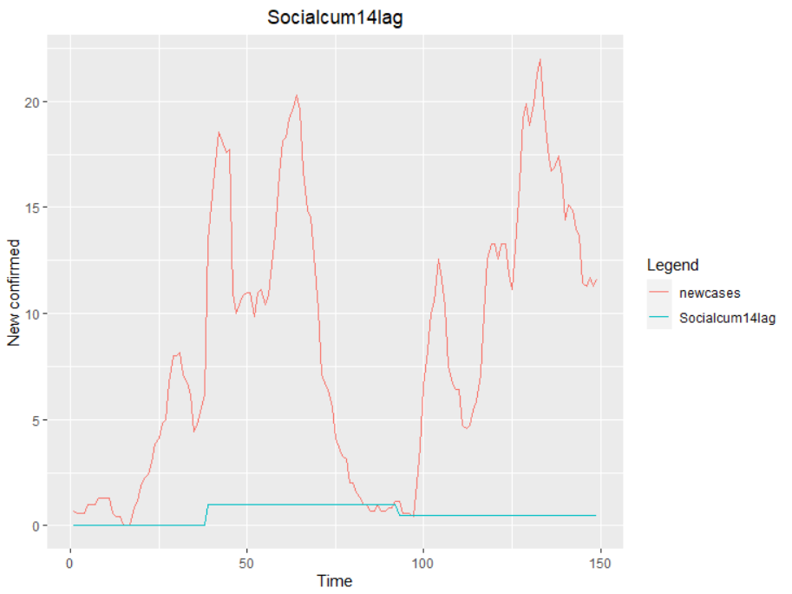
3.4 Data Cleaning
Handle policy as cumulative counts
Ex: policy start :=+1 ,policy weaken:=-0.5, policy end:=-1
Example: Social Distancing Campaign
14 day lag of social policy with corresponding date.
Period of policy imposed, case start going down.
Once the policy have weaken, the cases climated up again.

Slide 20
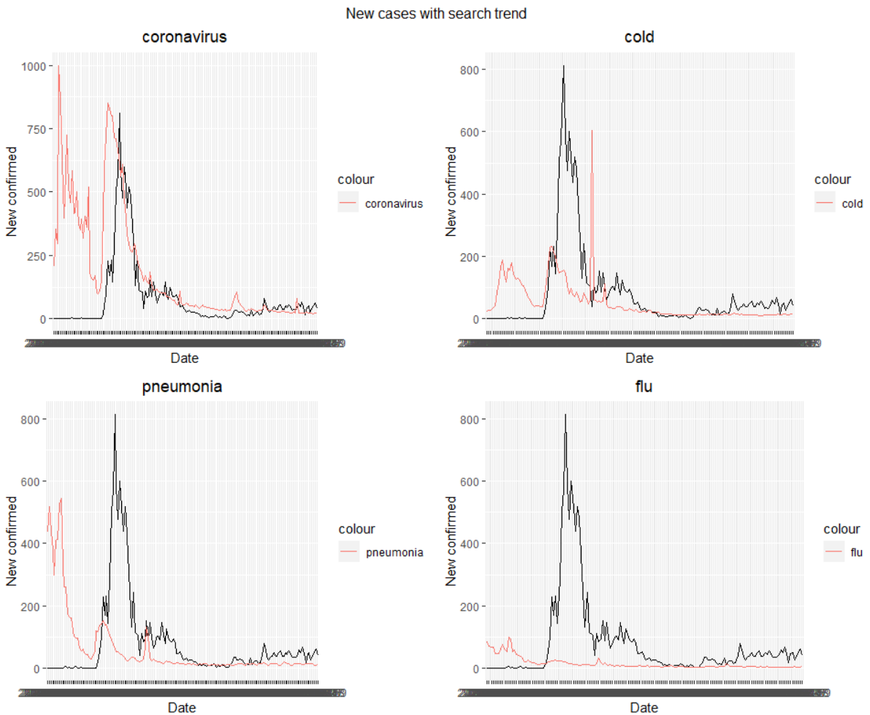
3.3 Data Cleaning
Two interpretation of Search Trend:
When people feel sick, they will search coronavirus, cold, and ect… for similar symptom.
News’ content scale about covid cases have positive association to the number of new cases per day. (Higher number of new confirmed ->more channel will talk about covid-> more search by people)
I modeled it as the latter case.

Slide 21
4. Model Selection
Split the Data
Consider model:
Random Forest (with scaled data)
OLS (irrelevant to scaling)
Ridge Regression, LASSO, Elastic Net (with scaled data)
SVM with different kernel function ( linear, polynomial and radial) and (with scaled data)
BSS with OLS (irrelevant to scaling)
Tune models with validation set and refit the model with optimal parameters.

Slide 22
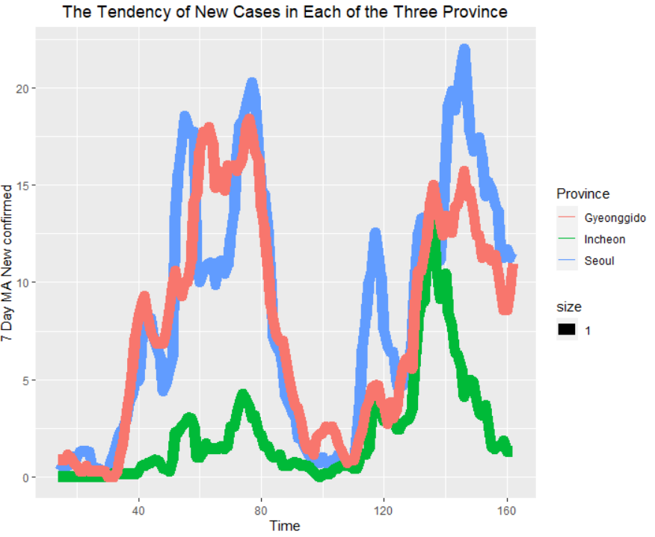
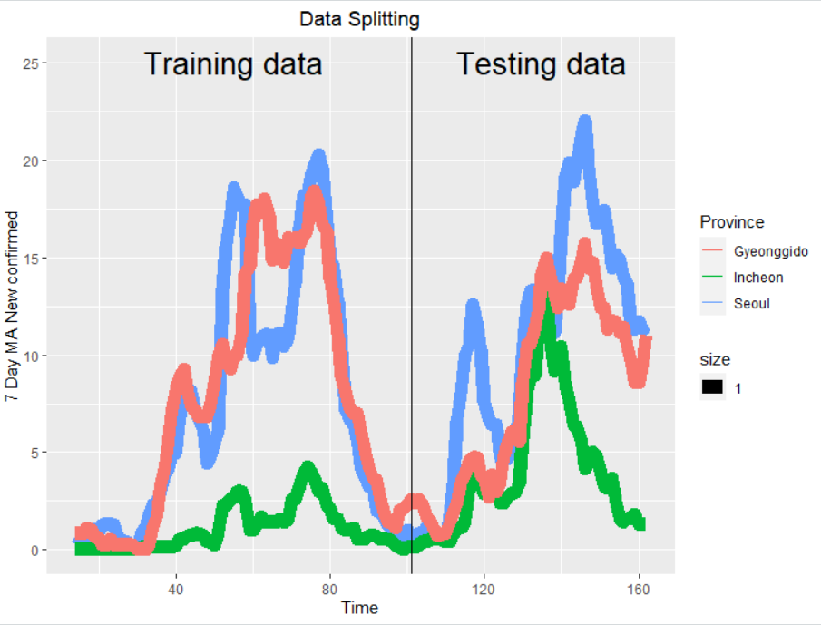
4.1 Data Splitting
First 100 days of these three provinces as training. (total 300 observations）
Split again randomly as training set and validation set. (each 150 observations)
Last 50 days of these three provinces as testing set. (total 150 observations）

Slide 23
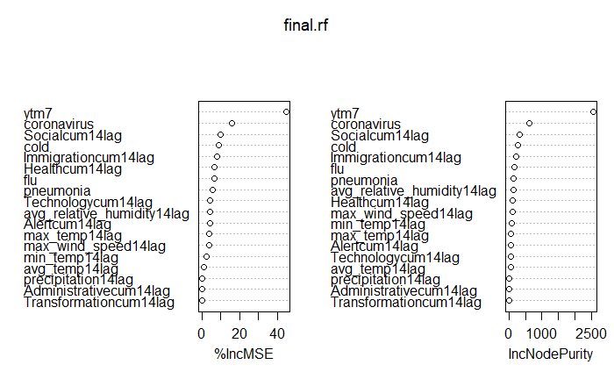
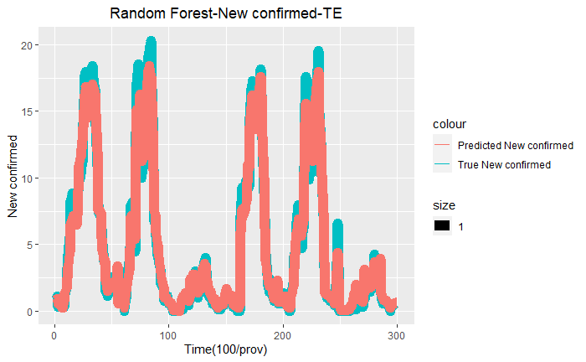
4.2 Random Forest
Tree=300
mtry=8
nodesize=5
Very high accuracy
ytm7 and coronavirus are the top two most picked as a node from tree building .
Notes:
when fitting a random forest, I started with mtry=p/3, around 8. for validation, I set it plus and minus 2, Number of tree, start at 50 to 300 tree. after using validation set, picked the optimal tree number equal to 300, optimal mtry =5, since we are doing a regression tree, I set the nodesize = 5. we can see the accuracy of random forest dealing with training data is very high. the important measure of ytm7 and coronavirus is higher than other predictors.top two most picked as a node from tree building.

Slide 24
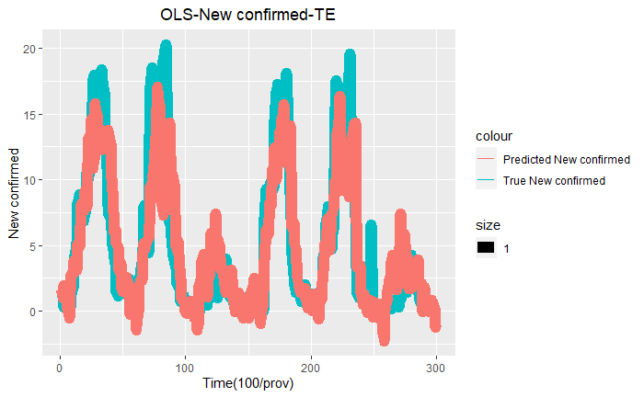
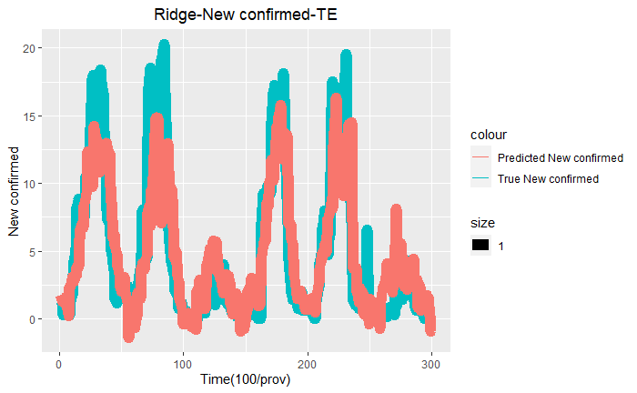
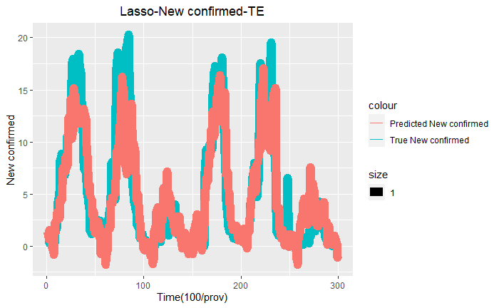
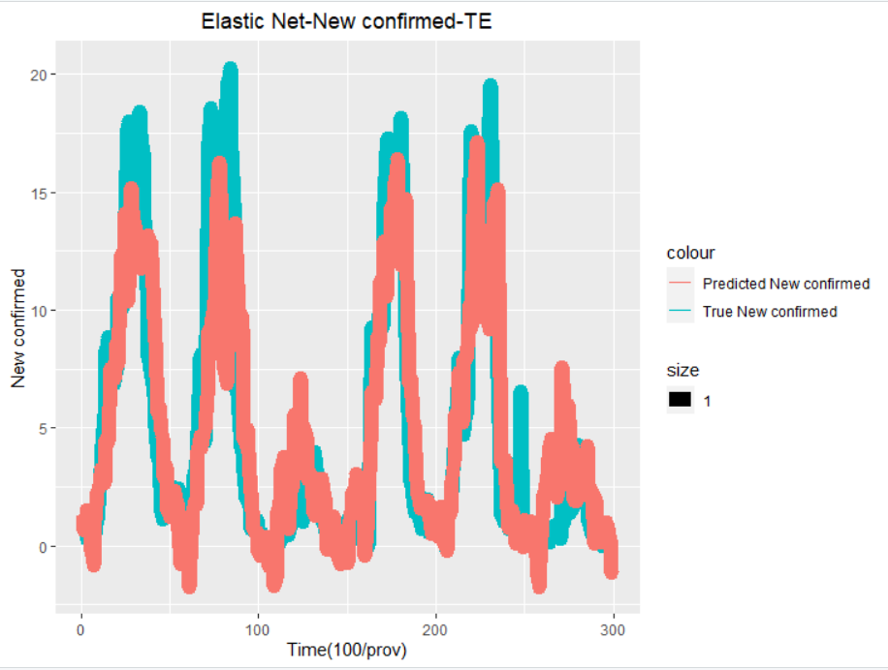
4.3 OLS, Ridge Regression, LASSO, Elastic Net

Slide 25
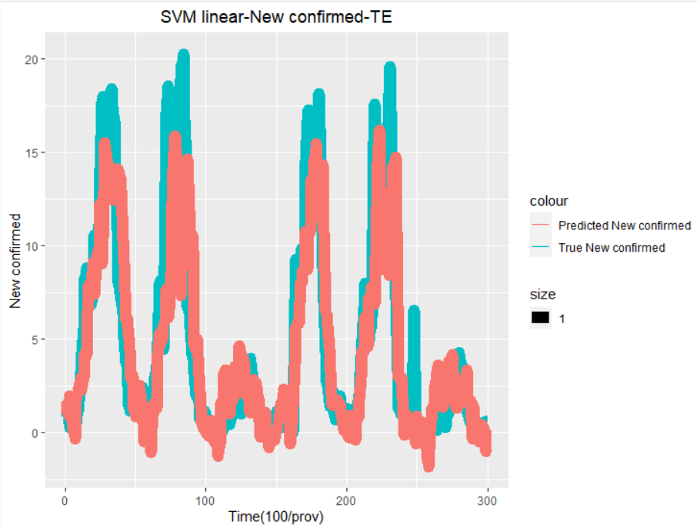
4.4 SVM
Validation Error Table
SVM Linear | 1.935991
SVM Polynomial | 2.504752
SVM Radial | 1.949734

Slide 26
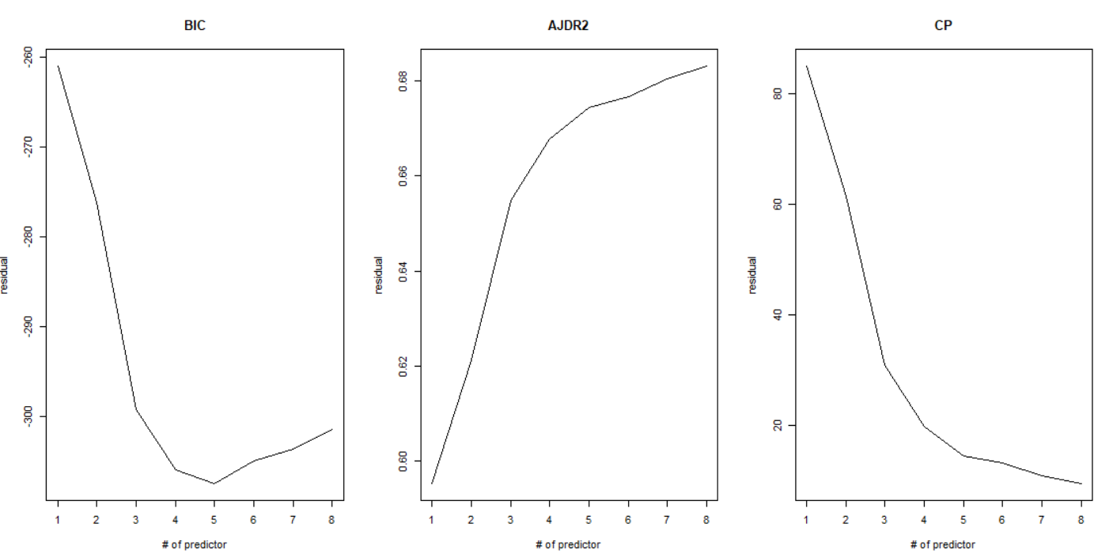
4.5 Best Subset- # of predictor

Slide 27
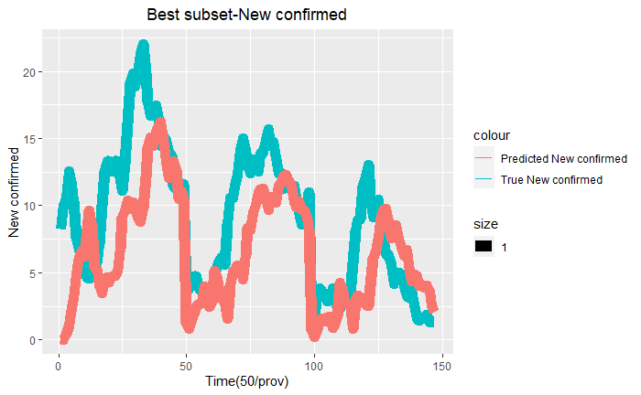
4.6 OLS Model after Best Subset
final_model =lm(newcases7dayMA ~
ytm7 + coronavirus+ avg_relative_humidity14lag + Immigrationcum14lag + Healthcum14lag ,
data = BigTrain)

Slide 28
4.7 Training Error Table
Random Forest | 0.5177971
OLS | 2.184255
Ridge Regression | 2.26555
LASSO | 2.192835
Elastic Net | 2.192835
SVM Linear | 2.133451
OLS after Best Subset | 2.181862

Slide 29
5. Prediction
Use testing set and fine tuned model to find prediction error.

Slide 30
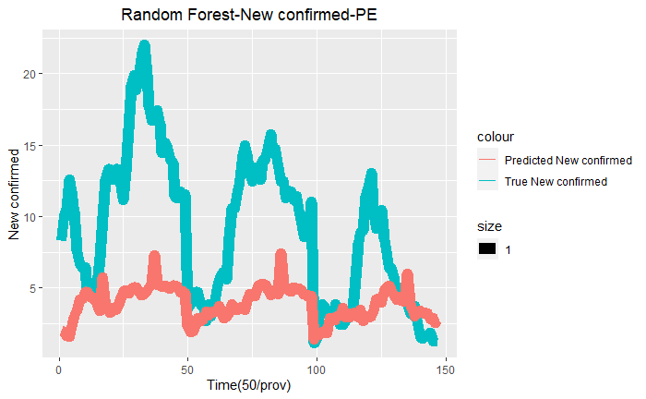
5.1 Random Forest
In prediction, random forest can model the trend of new confirmed.
But it did worst job in predicting the actual number of new confirmed compare to other algorithms.
Why?
Extrapolation (Testing Data set)
Decision trees and random forests are the algorithms which doesn’t have much to do with outside scope.
It doesn’t have any knowledge of what’s happening beyond the training space.( It happened the trend of testing data is very different from training data.)
Notes:
In prediction using training set, random forest did a good job in modeling the trend of new confirmed case, but it did a much worse job in predicting the actual number of new confirmed cases in testing data. The reason is the testing set is extrapolation. When we use decision trees or random forest, they cannot deal with outside scope.

Slide 31
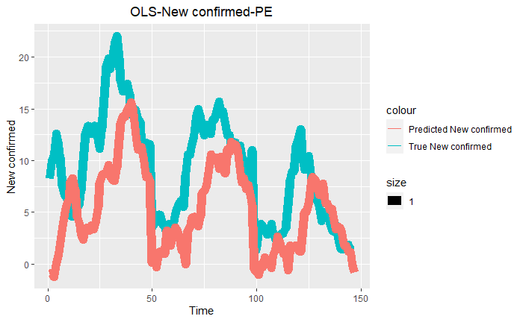
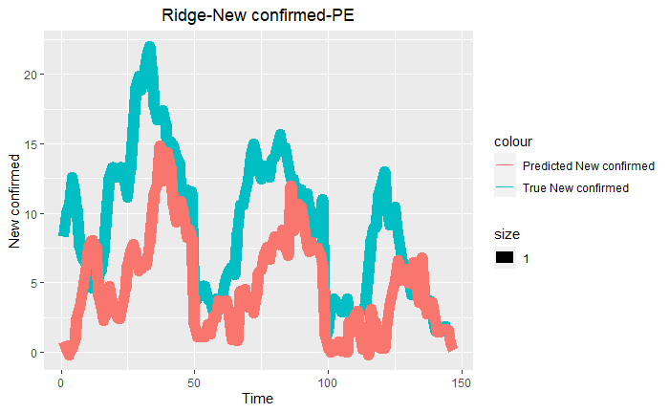
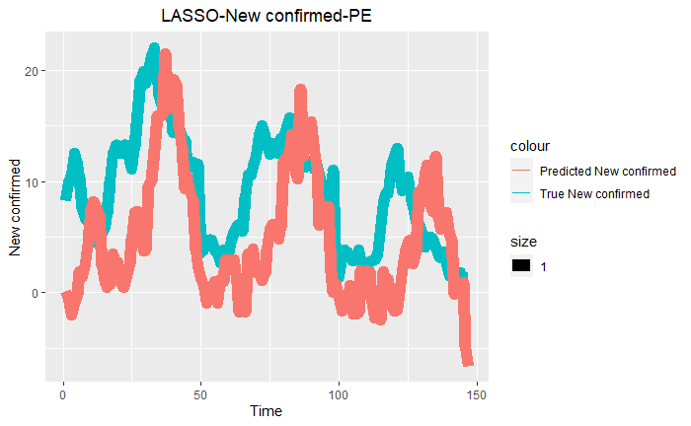
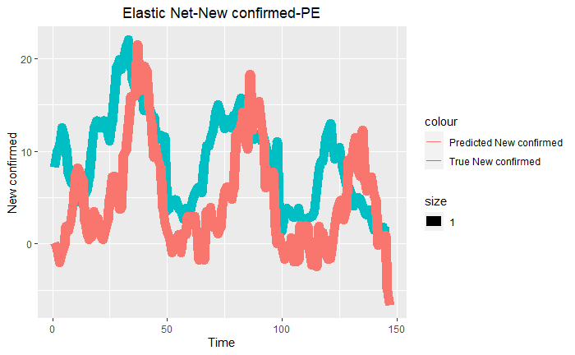
5.2 OLS, Ridge Regression, LASSO and Elastic Net

Slide 32
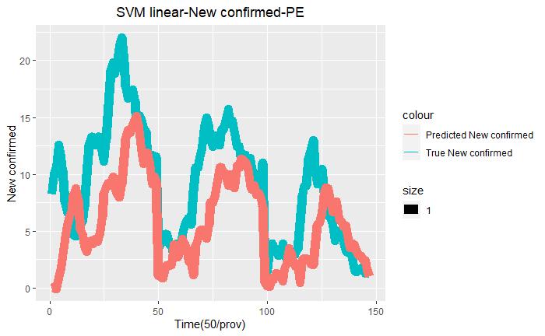

5.3 SVM and Best Subset

Slide 33
5.4 Prediction Error Table
Random Forest | 5.420197
OLS | 4.210133
Ridge Regression | 4.554649
Lasso | 5.547614
Elastic net | 5.547614
SVM Linear | 3.81019
OLS after Best Subset | 3.574929

Slide 34
6. Conclusion
Overall, the performance of all algorithms is not ideal.
The performance of these algorithms can be rank at three level.
Good: SVM Linear and OLS with Best Subset
Medium: OLS and Ridge Regression
Bad: Random Forest, Lasso, and Elastic net
Why?
SVM Linear with error tolerance to avoid overfitting and OLS with Best Subset removed multicollinearity and useless predictors
OLS and Ridge Regression ( can handle multicollinearity but still to many noise predictors )
RF as I explained, Lasso can not handle highly correlated data and Elastic net come out to choose alpha=1 from validation .
The performance of all algorithms is not ideal. Why?
Population data is not include in those kaggle datasets.( rate of spread)
Rate of Covid-19 incubation time is not stable(5-21 days).
Past data don’t have good representation of future data, because Covid-19 is epidemic disease.( new cases can be contributed my many unknown variable such as Covid variant)

Slide 35
THANK YOU

